Slide 1
University of Missouri System
Board of Curators
April 20, 2023
Audit, Compliance and Ethics Committee
Audit, Compliance and Ethics Committee
Quarterly Report
UM

Slide 2
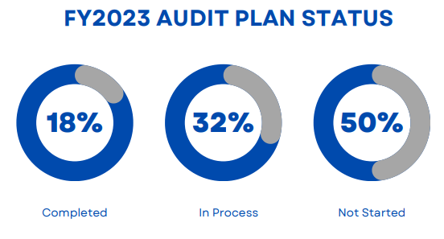
Summary of Internal Audit Activity
Five internal audit engagements completed
Nine internal audits/consulting engagements in process
Fourteen audits/consulting projects not started
Seven investigations completed
Actively working four investigations

Slide 3
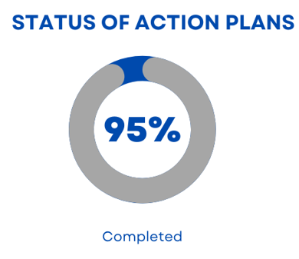
Status of Management Action Plans As of February 28, 2023
Twenty-four action plan items in eight audits were reviewed for completion as of February 28, 2023.
Twenty-three of twenty-four, or 95 percent were completed.
One action plan in one audit was assigned an extended due date.
All action plans in 6 audits are complete, and the audits are closed.

Slide 4
Youth Protection Program

Slide 5
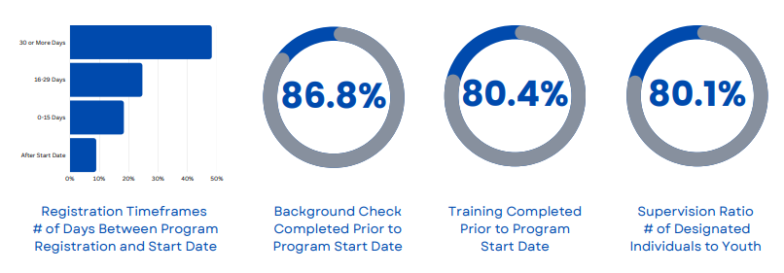
Youth Program Metrics

Slide 6
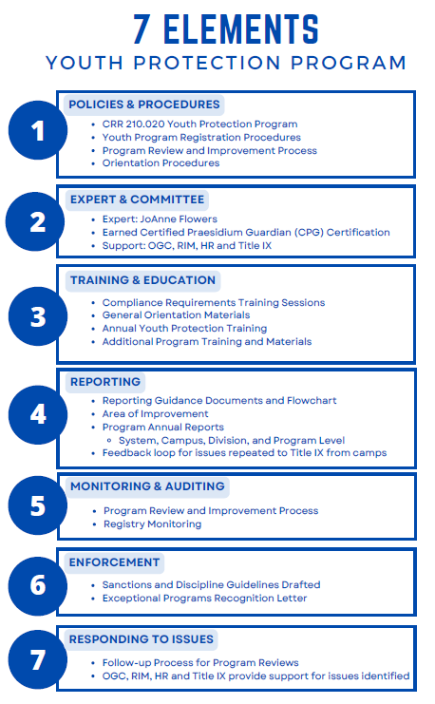
7 Elements Youth Protection Program

Slide 7
Questions?

